Slide 1

Halotechnics Electricity Storage: Enabling Renewable Peaker Plants
Presented to Shell GameChanger
July 10, 2013
www.halotechnics.com

Slide 2

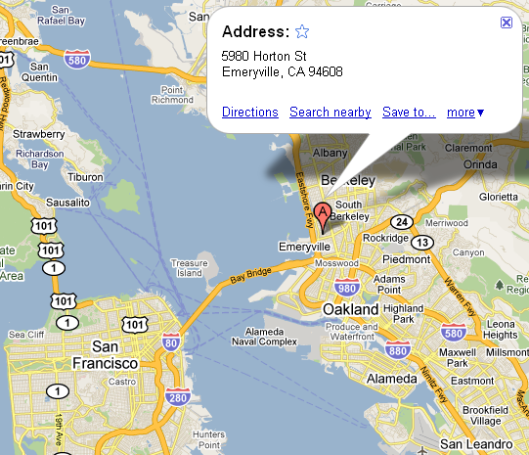
Company profile of Halotechnics, Inc.
High temperature fluids are the key to abundant clean energy
Headquarters in Emeryville, California with fully equipped chemistry and engineering labs
$6.5 million in federal grants to date from NSF, DOE, NREL, and ARPA-E
Experts in materials science, chemistry, and engineering on staff
Halotechnics, Inc.

Slide 3
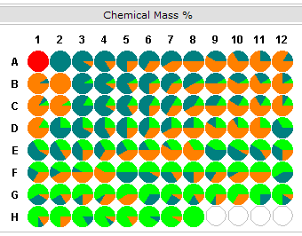
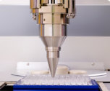
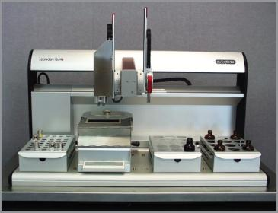
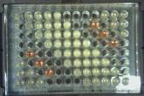
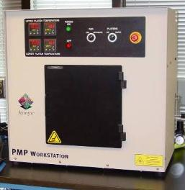
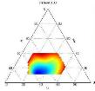
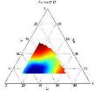
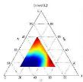
Defensible IP position
Proprietary fluids for high temperature energy storage
12 patent applications filed to date
Proprietary software and automated lab equipment
Can screen up to 100 mixtures/day
Screened over 22,000 mixtures to date

Slide 4
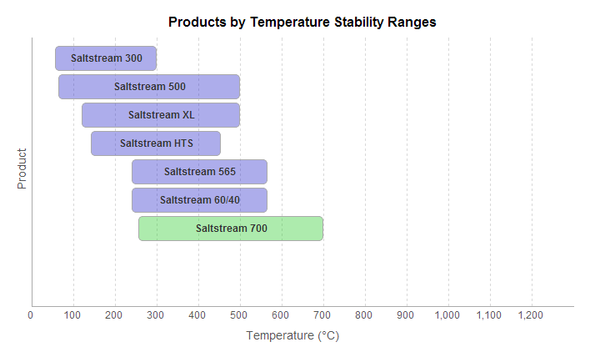

Halotechnics thermal fluids
Saltstream and Haloglass
Enabling a new class of applications in extreme heat

Slide 5
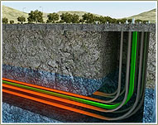
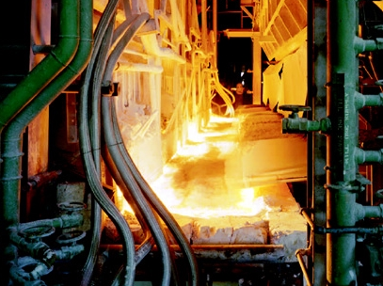
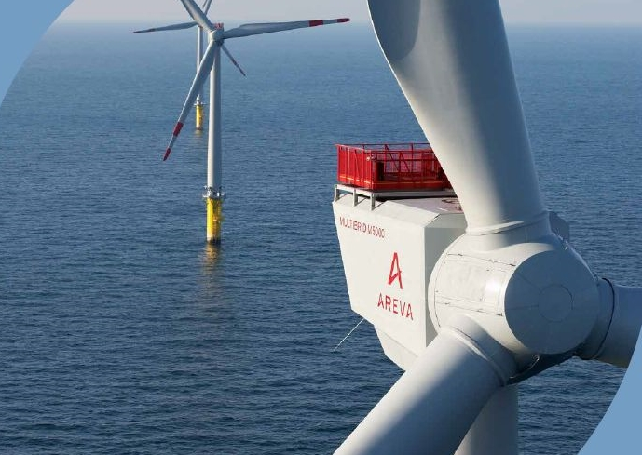
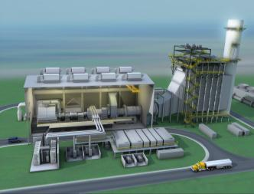
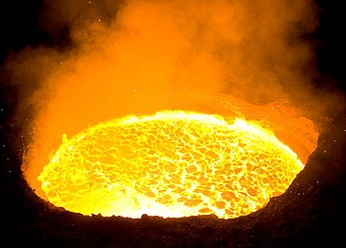
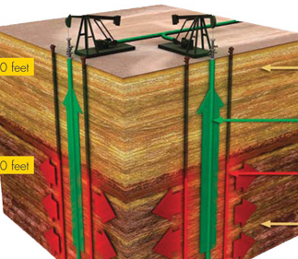
Halotechnics thermal fluids applications
Heavy oil upgrading
Reliable
wind power
Glass manufacturing
Renewable peaker plant
Steel manufacturing
In-situ oil shale conversion
Thermal Electricity Storage
Waste Heat Recovery
Energy
Halotechnics Thermal Fluids Platform

Slide 6
Reverse heat engine electricity storage
RHEES
Efficient electricity storage enabled by Halotechnics thermal storage technology
Grid scale storage that’s cheaper than peakers
70% round trip efficiency, $150/kWh capital cost (compare to batteries at $500+/kWh)
Scalable to hundreds of megawatts!
1200 °C
400 °C
Halotechnics
hot storage
Motor/
Generator
water-based
cold storage
25 °C
-100 °C

Slide 7
Heat pump 101
Enabling technology is heat pump + thermal storage
Heat pumps use electricity to drive heat “uphill” from cold to hot
Key metric is Coefficient of Performance (COP)
COP = Hot Flow / Electricity Input
COP can be greater than 1
More effective than simple resistive heating which is “only” 100% efficient
HOT
50 kW
30 kW
electricity
Heat
Pump
20 kW
COLD
Opportunity to upgrade waste heat from Shell refinery or chemical plant

Slide 8

Heat pump charge
Charge: Use turbine to compress inert gas
Store heat in Haloglass
Store cold in water based mixture
1200 °C
400 °C
Halotechnics
hot storage
Motor/
Generator
compress
expand
water-based
cold storage
25 °C
-100 °C

Slide 9
Heat engine discharge
Discharge: Utilize turbine in standard heat engine mode
Use heat in Haloglass to heat gas and generate power
Use cold to chill inlet gas and increase efficiency
1200 °C
400 °C
Halotechnics
hot storage
Motor/
Generator
expand
compress
water-based
cold storage
25 °C
-100 °C

Slide 10
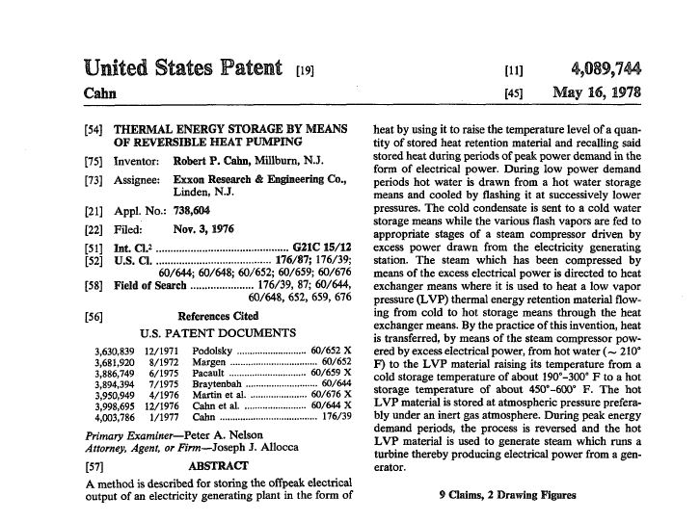
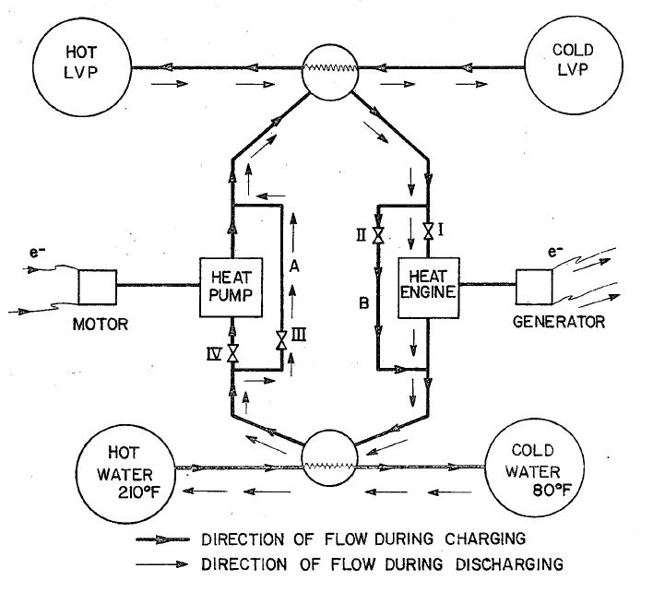
Old idea enabled by new materials
GameChanger-Halotechnics project to build first of a kind thermal electricity storage system
Halotechnics high temperature fluids are the first to make the concept commercially viable
The hotter, the better…

Slide 11
The hotter the better
Two fundamental truths drive our work. As storage temperature increases:
Efficiency goes up
Cost goes down
RTE = COP x η
Gen 1 (salt)
Gen 2 (glass)
Gen 1 (salt)
Gen 2 (glass)

Slide 12
Opportunity framing workshop
Partner
Strategy
POC Validation
1 MW Deployment
Commercial
Phase 3
Phase 4
Impact
Operational
OFW May 9, 2013
Economic
Proof of Concept
[limit of GameChanger funding]
Phase 1-2
Difficulty to Test

Slide 13


GameChanger Project
GameChanger project
$1 million
Leverage additional NSF funds:
+$100k with letter of support
+$500k with $1M investment
Sept
2013
Sept
2014
Proof of Concept: Verify turbine operation as a heat pump
Prove that Brayton cycle turbomachinery can operate as a high temperature heat pump. Eliminate key risk.
$1 million, 12 month program to design 1 MW pilot and obtain lab scale performance data
Subsequent effort to build and deploy 1 MW pilot system

Slide 14
Overall project timeline
 | Market analysis and preliminary design |  |  | Detailed design |  |  | Fabrication and testing proof of concept
 | $200k |  |  | $300k |  |  | $500k
 | Phase 1 |  |  | Phase 2 |  |  | Phase 3
Task or Milestone | 1 | 2 | 3 | 4 | 5 | 6 | 7 | 8 | 9 | 10 | 11 | 12
Quantitative competitive analysis
Economics/market analysis
Compressor and EPC partners
Preliminary design
Toll Gate: Preliminary design spec
Detailed design
System controls and instrumentation
Toll Gate: Detailed design spec
Fabricate lab scale test rig
System testing
Identify site for 1 MW pilot
Toll Gate: Performance data
Three-phase GameChanger project eliminates key risks up front

Slide 15
Phase 1 deliverables
Phase 1 deliverables:
Recommended design for continued refinement under Phase 2.
Draft P&ID
Draft Heat & Mass Balance
Draft Bill of Materials
Report that describes the competitive landscape in storage and first markets for deployment
Documented information from at least one vendor on feasibility and/or cost of pilot plant compressor/expander components
Preliminary system cost estimate for 1 MW pilot
Preliminary performance estimate for 1 MW pilot
Storage plant pro-forma financials. This document will require the results from both system cost analysis and performance modeling. Calculate the IRR and LCOE.
Operational
Commercial
Partner Strategy
Economic

Slide 16
Lab scale system design
First of a kind high temperature heat pump
Low temp heat input 25-100 °C
High temp heat output 200+ °C
Design for gas temperatures low enough to allow stainless steel construction
Utilize available components whenever feasible (compressors, expanders, controls)
High Quality Heat Out
Hot heat exchanger
Electricity In
Motor
compress
expand
Cold heat exchanger
Low Grade Heat In

Slide 17
Key deliverable
Show that the heat pump can achieve a Coefficient of Performance greater than one
COP > 1

Slide 18
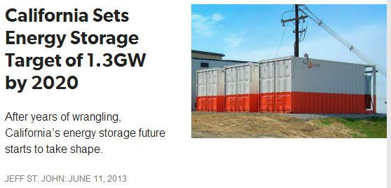
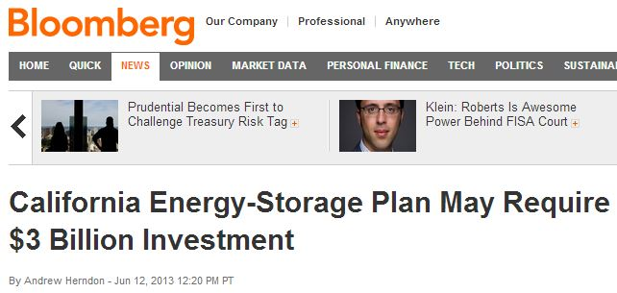
Gathering momentum for storage
Shell Energy North America is a player in the California market
“AB 2514 requires storage procurement targets for load-serving entities, including direct access electric service providers (ESPs)...”

Slide 19

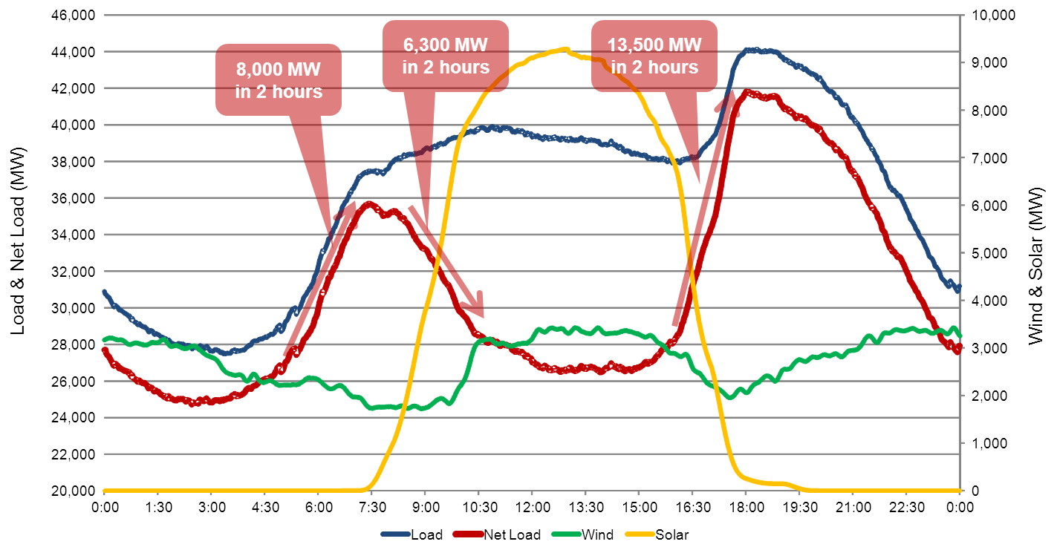
The demand for electricity storage
Typical Day, Winter/Spring 2020
CAISO predicts 12,000 MW storage needed for 3 hours,
twice a day to stabilize renewables’ intermittency

Slide 20
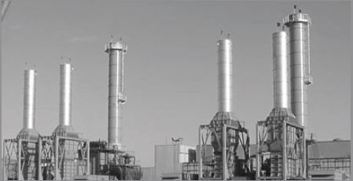
Application 1: Renewable peaker plant
Find the cheapest source of energy
Off-peak electricity in areas of high wind penetration
Sell it at the highest value
Late afternoon peak demand on hot days
This a proven business model.
It’s a peaker plant!

Slide 21
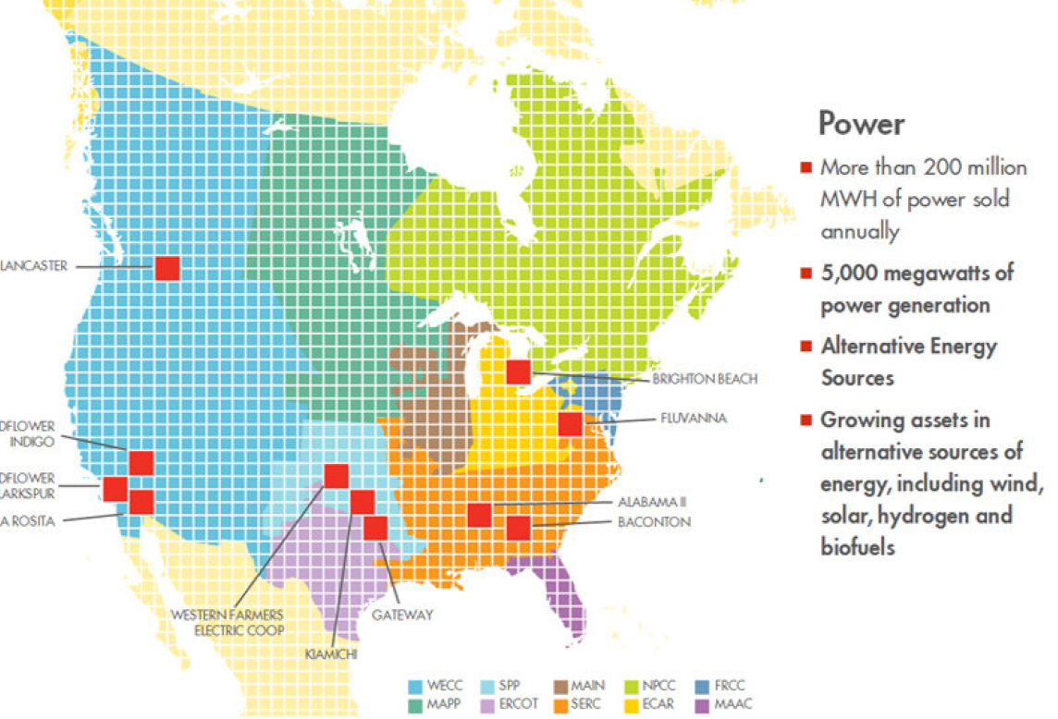
Application 2: Energy trading
Storage provides optionality to energy traders
Shell Energy North America is a leader in this market
Energy trading promotes grid stability
Storage allows arbitrage based on time of day pricing and other ways to optimize procurement contracts
Input from Shell will add value to the storage solution

Slide 22
Becoming a leader in storage
There will be a large market demand for ~100 MW storage plants
There is no existing storage technology that can meet this demand, due to technical or economic shortcomings
Halotechnics has the solution and can offer valuable engineering services to EPC’s building the storage plants according to our design
Halotechnics has unparalleled capabilities to develop proprietary thermal storage materials for storage plant designs
Shell brings strategic value as a partner and customer for Halotechnics advanced storage plants

Slide 23
Project Team
Justin Raade, PhD
CEO and Founder
Dr. Raade has 12 years experience in advanced materials and energy storage and has led several multidisciplinary R&D teams. His doctoral research at UC Berkeley was focused on applied thermodynamics and energy storage using hybrid systems with fuel cells and lithium polymer batteries. He has an undergraduate degree from MIT.
Milton Venetos
Energy Systems Modeling Guru
Milton Venetos has 20 years of experience in the power generation sector. He was most recently Senior Vice President of Product Management at Areva Solar. He has worked extensively with modeling the performance of gas turbines, solar power plants, and other industrial processes.
Jeffrey Pickles
Director of Engineering
Jeff Pickles has 14 years of experience in high temperature materials and thermal system engineering as well as renewable energy project development. He developed fuel reforming systems for portable fuel cells as a Program Manager at Altex and previously at InnovaTek. Jeff also performed financial analysis on renewable energy projects at Energy Northwest.
Grady Hannah
Director of Business Development
Mr. Hannah has 10 years experience in Silicon Valley technology companies. He sold enterprise Linux solutions and Open Source cluster technology and later transitioned into the video game software market. Recently his sales led directly to a $10 million B Round while he was at Replay Solutions.
Matt Jonemann
Turbine Test Engineer
Matt has 7 years of control systems engineering experience including previous experience at GE Aviation developing test equipment for gas turbine engines. Matt will be leading the turbine charging/discharging controls development. Matt has a M.S. and B.S. in Mechanical Engineering from Stanford.
John Huffaker
Corporate Development Advisor
John Huffaker has 17 years of Corporate Development experience in the technology and energy sectors. He was most recently Vice President of International Business Development at Areva Solar. He has worked in Asia, India, the Middle East, Europe and South America forming strategic alliances with a wide variety of industrial companies.

Slide 24
Scale-up toward commercial deployment
Shell GameChanger
+ NSF Grant
Shell Technology Ventures
+ Equity Investors
+ DOE Grant
Shell Pathfinder
+ Strategic Investor
+ EPIC Grant
Project finance
$1 million for 1 MW design and controls
$8 million for 1 MW build and deploy
$30 million for 10 MW demo project
Sign PPA for 1000’s MW
Deploy
commercial projects
Lucrative acquisition target
2013
2014
2015
2016
2017
2018

Slide 25
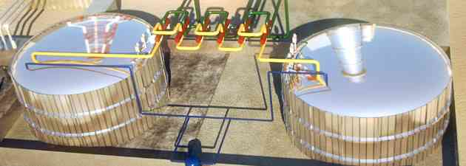
Renewable peaker plant
Sal Caliente Storage Plant
Item | Description
Technology | Halotechnics RHEES
Rated power | 1 MW
Operation profile | 8 hour charge, 4 hour discharge
Storage | 100 tons Saltstream thermal storage
Location | 90 miles Southeast of Lubbock, Texas
Off-taker | TXU Energy, ERCOT territory
Fuel costs | $15/MWh off peak electricity
PPA | $300/MWh, estimated 10% capacity factor
Capital cost | $8 million
Commissioning | June 2015

Slide 26
Extra slides

Slide 27
Phase 2 deliverables
Phase 2 deliverables:
Front end engineering design (FEED) study for 1 MW pilot
Final P&ID
Final Heat and Mass Balance
Final Bill of Materials
3D SolidWorks models and simulations for entire system and major components showing project foot print and detailed designs for the cold tank, hot tank, pumps, heat exchangers.
Hardened budget and component vendors for 1 MW pilot
Control algorithm for 1 MW pilot
Design of lab scale test rig
Quotes for components of lab scale test rig
Updated pro-forma
Operational
Partner Strategy
POC Validation
Economic

Slide 28
Phase 3 deliverables
Phase 3 deliverables:
Lab scale heat pump with data showing COP > 1 and generating heat flow at >200 °C
Verification of control algorithm for system start up, continuous operation, and shut down
Down select from candidate pilot plant sites and specify chosen site
POC Validation
Deployment

Slide 29
Budget justification
Item | Description | Cost
Direct Labor | Actual salaries | $306,400
Overhead and Fringe Benefits | Rent, legal, patents, SG&A, benefits | $306,400
Materials and Supplies | computers, tools, piping, heaters | $110,000
Facility Updgrades | electrical, ventilation, plumbing | $40,000
Equipment | compressor and expander, heat exchangers | $80,000
Travel | visit compressor vendor, customer sites | $19,500
Consultants | turbine modeling and test setup | $78,300
Other Costs | 3D modeling software, simulation and controls | $60,000
TOTAL ($) |  | $1,000,600
Aggressive project scope and timeline requires staffing of experienced professionals
Project Manager
Two FTE thermal/mechanical engineers
One FTE technician (mechanical and electrical)
Partnerships and customer development

Slide 30
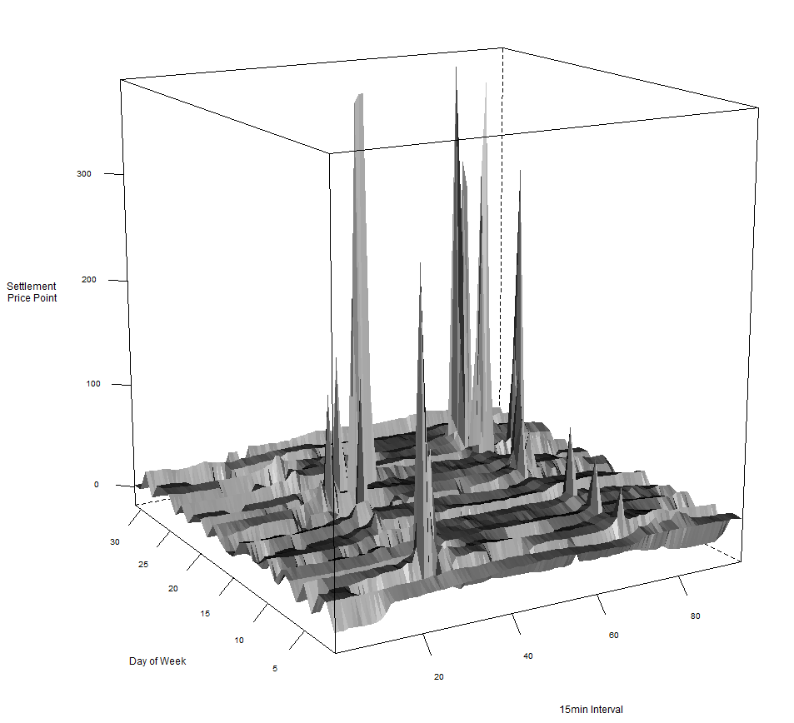
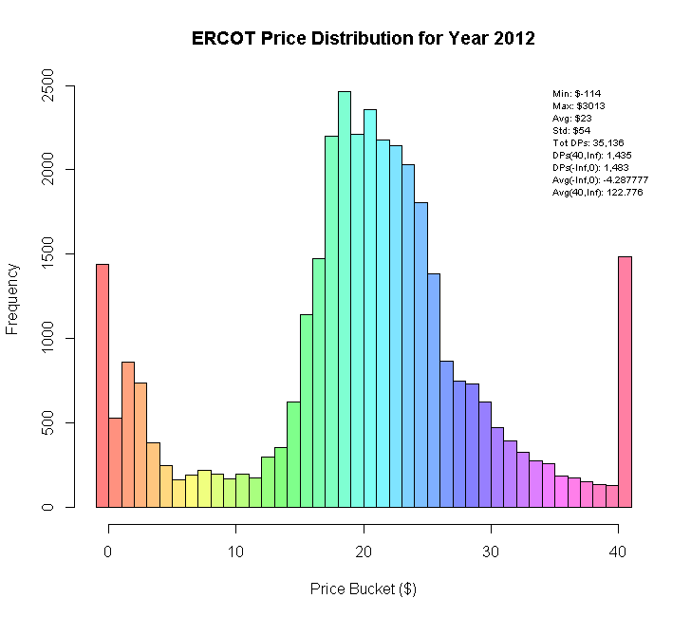
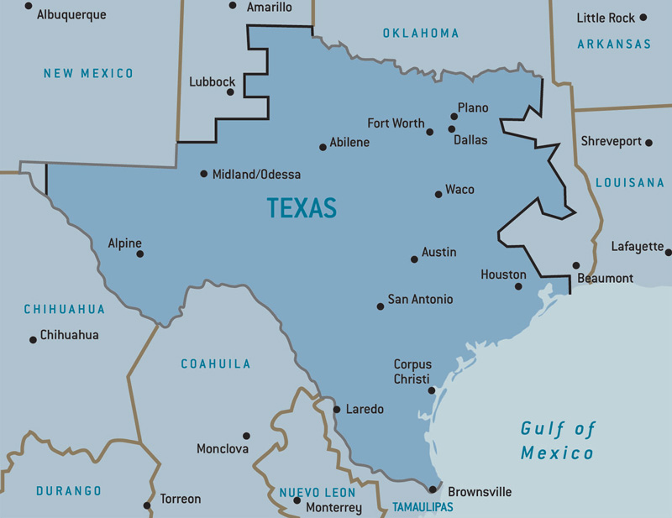
Analyze pricing data
pricing data at site
Electricity pricing data varies by time of day, season, and location
Halotechnics has developed proprietary software tools to analyze ERCOT and CAISO pricing data to determine optimum locations for facilities

Slide 31
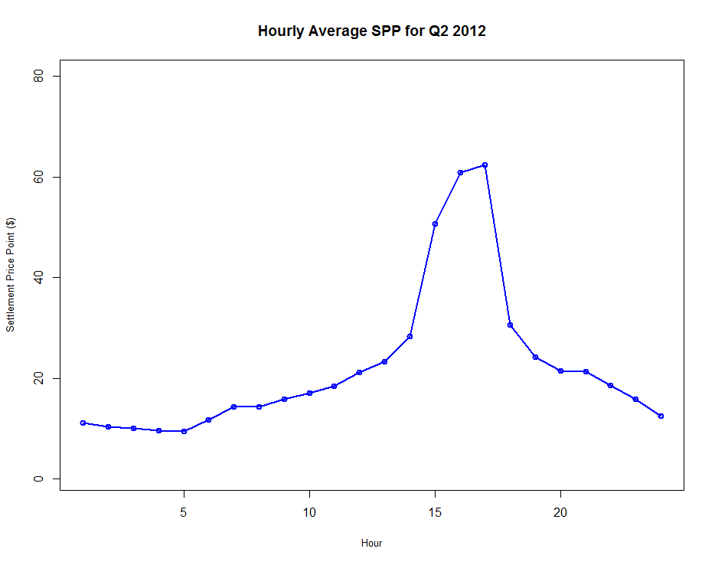
Revenue opportunity
Enable electricity arbitrage.
ERCOT bulk electricity settlement price data
CAISO situation is similar
Sell energy here
Value
Store energy here
Hour of day
Notes:
Provide value to customers

Slide 32


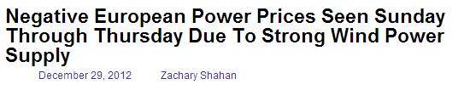
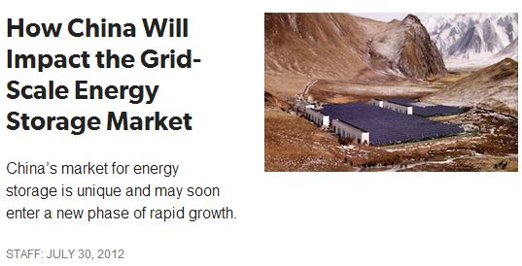
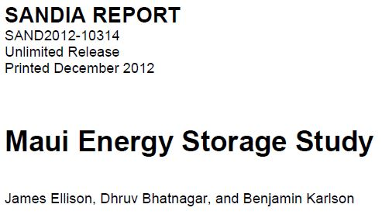
Storage is needed worldwide

Slide 33
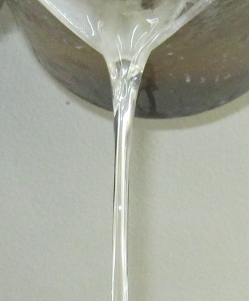
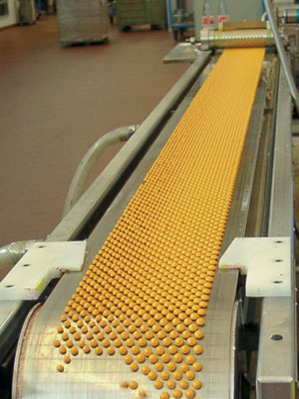
SaltstreamTM
Broad product range of Saltstream nitrate and chloride salts
Low-melting point, yet stable to high temperatures
Halotechnics has capability to deliver orders up to 1 metric ton
Scalable manufacturing process for larger orders
Saltstream 700
FLiNaK
60/40 solar salt
200
300
400
500
600
700
°C
Pastillation
Low melting point, stable fluids for applications from 50°C – 700 °C

Slide 34
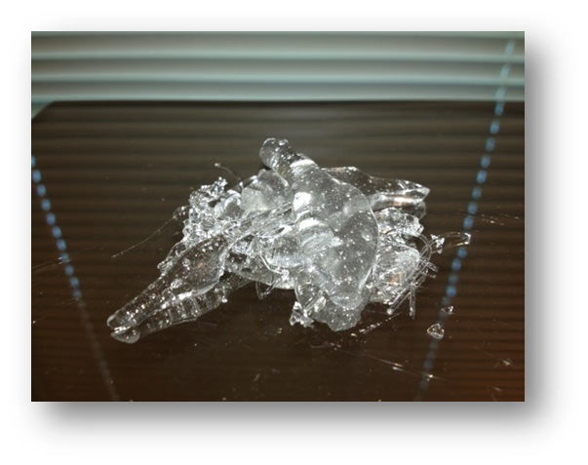

HaloglassTM
Haloglass RX
Haloglass CK
Low viscosity, high heat capacity fluids for applications exceeding 1000 °C

Slide 35
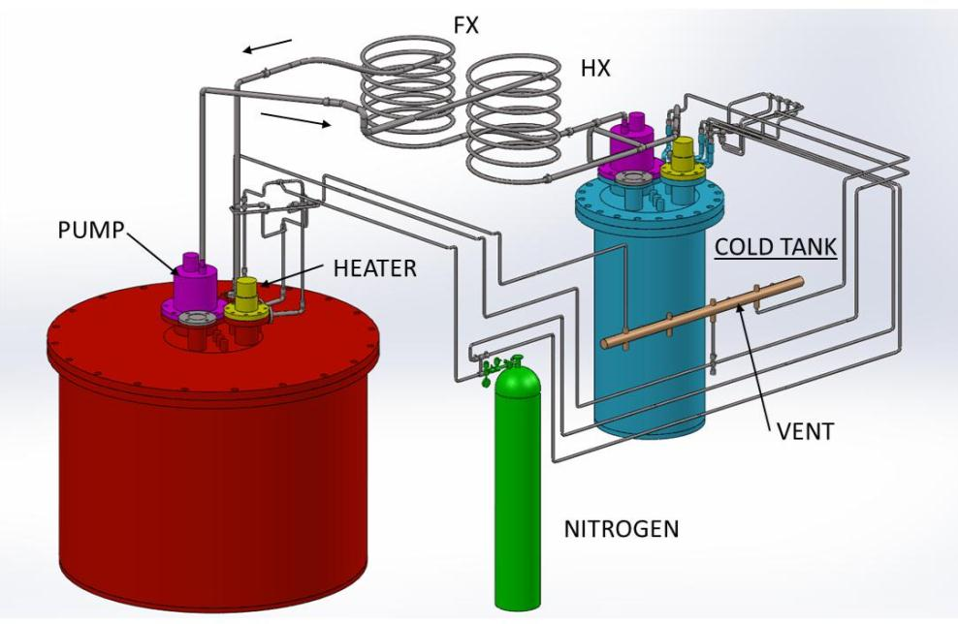
Highest temperature thermal storage
5 kW
5 kW
HOT TANK
Pilot scale 700 °C thermal storage system complete (30 kWh, 300 kg salt)
Funded by $1 million NREL SunShot Incubator award
Notes:
Halotechnics is developing the complete engineering solutions for thermal storage systems in addition to the materials science development of the fluids

